Slide 1
NIMH Update Succeeding in Mental Health and Aging Research March Webinar
Liz Necka (Lyons), PhD
NIMH, Division of Translational Research
Geriatrics and Aging Processes Research Branch
March 31, 2026

Slide 2
Disclosures
No conflicts to disclose

Slide 3
Agenda
NIMH and NIH Strategic Plans and Directors’ Updates
NIMH Geriatrics & Aging Processes Research Branch Interests and Initiatives
NIH and NIMH Grant Application and Review Changes
Open Discussion

Slide 4


NIMH Vision and Mission

Slide 5
NIMH Extramural Division Structure
Division of Neuroscience and Basic Behavioral Science (DNBBS)
Division of Translational Research (DTR)
Division of Services and Interventions Research (DSIR)
Division of AIDS Research
Division of Data Science and Technology
Center for Global Mental Health
Strategic Objective 1
Strategic Objective 2
Strategic Objective 3
Strategic Objective 4
Define mechanisms of complex behaviors
Determine when, where, & how to intervene
Strive for prevention and cures
Advance Mental Health Services
Pre-Clinical
Early Efficacy
Effectiveness
5

Slide 6
Areas of Emphasis
Suicide
Genomics
Global Mental Health
https://www.nimh.nih.gov/research/priority-research-areas

Slide 7

NIMH Director’s Update – January National Advisory Mental Health Council Meeting
On February 3, 2026, the President signed the FY26 Labor, Health and Human Services, Education, and Related Agencies (LHHS) Appropriations bill
Includes $47.3 billion for NIH
Includes $2.3 billion* for NIMH
*Includes funding from the 21st Century Cures Act

Slide 8
NIMH Director’s Update – January National Advisory Mental Health Council Meeting

Slide 9
NIMH Director’s Update – January National Advisory Mental Health Council Meeting
*Excludes grants funded by 21st Century Cures Carryover funds

Slide 10
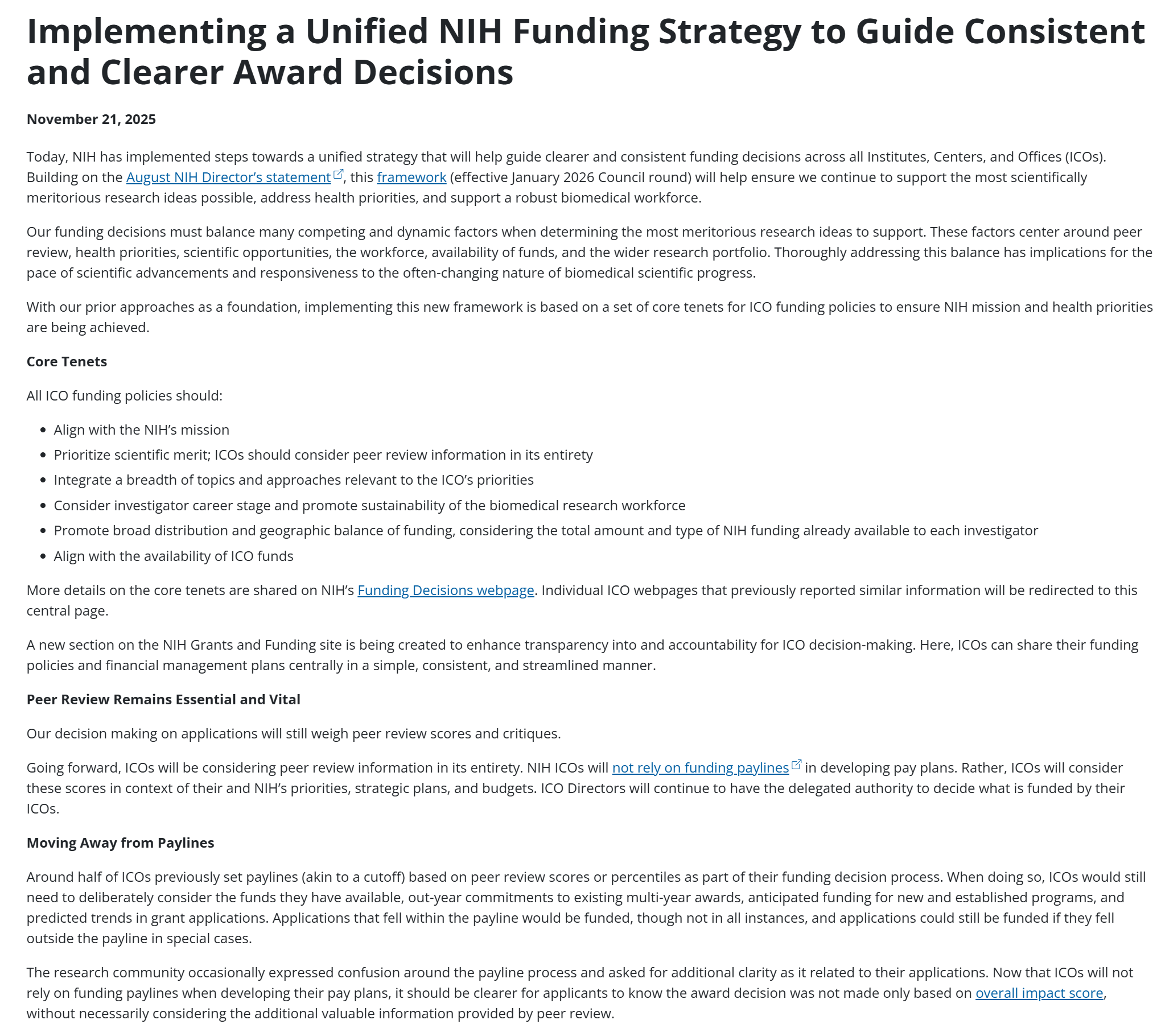
Unified NIH Funding Strategy
https://grants.nih.gov/news-events/nih-extramural-nexus-news/2025/11/implementing-a-unified-nih-funding-strategy-to-guide-consistent-and-clearer-award-decisions
https://www.nih.gov/about-nih/nih-director/statements/advancing-nihs-mission-through-unified-strategy

Slide 11
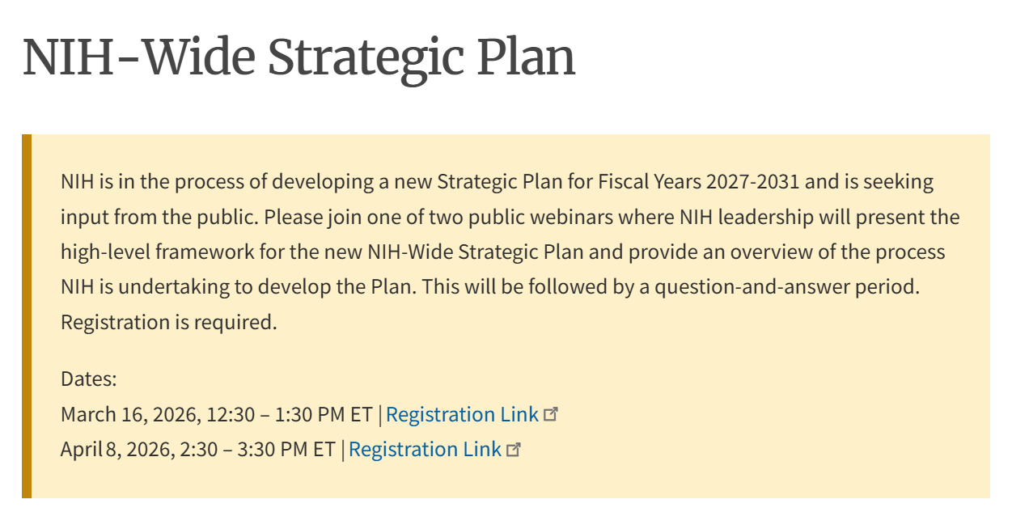
NIH-Wide Strategic Plan for FY27-31
NOT-OD-26-047: Request for Information (RFI): Inviting Comments and Suggestions on a Framework for the NIH-Wide Strategic Plan for Fiscal Years 2027-2031 (Due May 16, 2026)
Priority 1: Research Areas
Goal 1: Advance Foundational Knowledge of Human Health and Disease
Goal 2: Prevent Disease and Promote Health Across the Lifespan
Goal 3: Advance and Optimize Interventions, Treatments, and cures
Priority 2: Research Capacity
Goal 1: Develop and Sustain an Interdisciplinary Research Workforce
Goal 2: Build, Improve, and Sustain Research Resources and Infrastructure
Priority 3: Research Operations
Goal 1: Enhance Scientific Stewardship and Decision-Making
Goal 2: Foster Transparency and Accountability to Improve Public Trust in Science
https://www.nih.gov/about-nih/nih-wide-strategic-plan

Slide 12
NIH’s Path to a Simpler Funding Opportunity Landscape
NIH is streamlining the landscape for Notices of Funding Opportunities (NOFOs, or funding opportunities) and the application process. We are placing greater emphasis on investigator-initiated science rather than asking researchers to align their work with highly specific funding opportunities.
Limit number of NOFOS and increase reliance onf parent announcements
Greater flexibility to investigators
Less administrative complexity
Fewer funding opportunities ≠ fewer funded applications

Slide 13
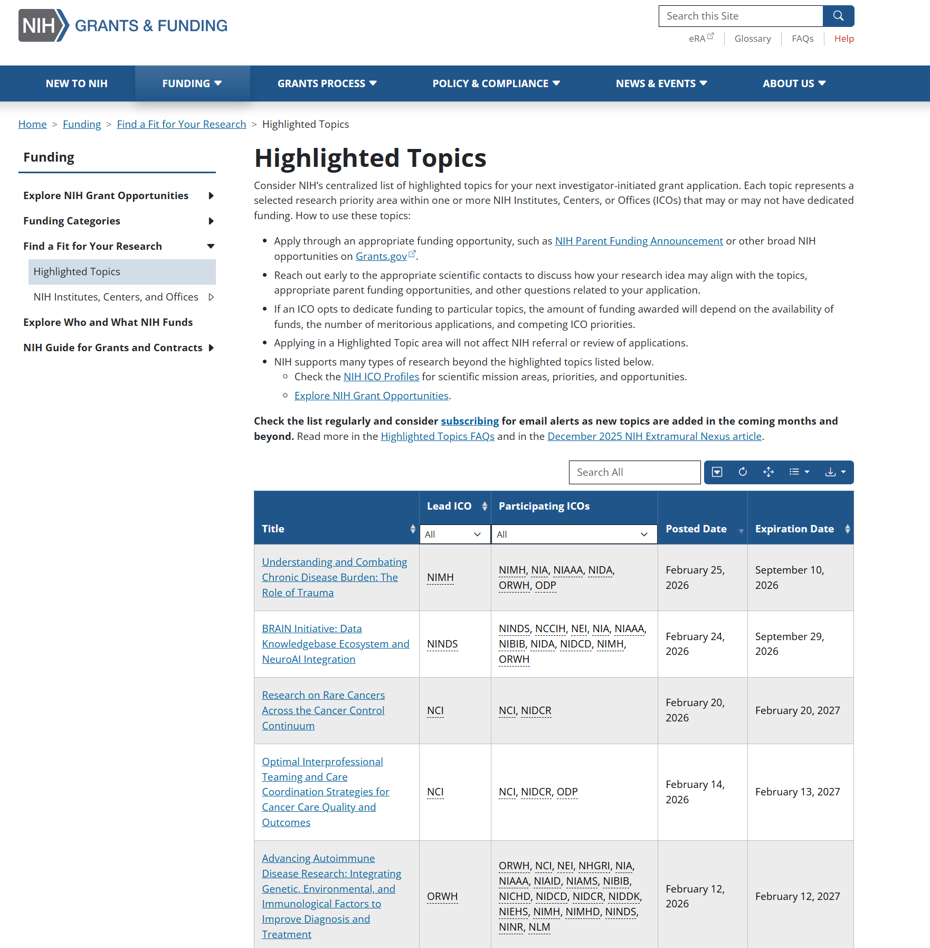
Highlighted Topics
New as of 2025
Communication tool to promote a particular area of science within the NIH mission and encourage investigator-initiated applications
Different from a NOFO or NOSI. HTs are:
Less prescriptive
Not tied to specific NOFO
Not funding opportunities
Do not impact referral or review
https://grants.nih.gov/funding/find-a-fit-for-your-research/highlighted-topics

Slide 14
NIMH Geriatrics & Aging Processes Research Branch

Slide 15
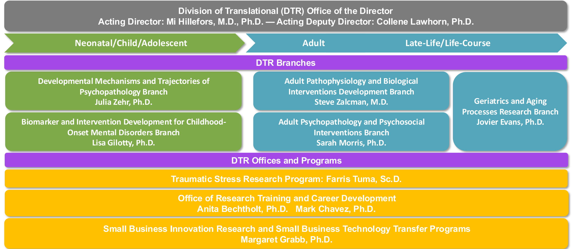
Division of Translational Research

Slide 16
Areas of Emphasis
Predictors and mechanisms of late-life mental disorders (esp. genetic, neurobiological, physiological, cognitive, psychosocial, and disability)
Trajectories of chronic mental illnesses across the lifespan; pathways of influence of earlier life trauma
Novel treatment development and approaches
Predictors and mechanisms of variability in treatment response (esp. genetic and brain structure/function factors)

Slide 17
Research Programs
Behavioral Science of Mental Disorders and Aging (PO: Necka)
Neuroscience of Mental Disorders and Aging (PO: Necka)
Psychosocial Intervention and Aging (PO: Evans)
Pharmacologic and Somatic Intervention and Aging (PO: Evans)
https://www.nimh.nih.gov/about/organization/dtr/geriatrics-aging-processes-research-branch

Slide 18
Behavioral Science of Mental Disorders and Aging
Approaches:
Basic and translational social and behavioral science
Clinical geropsychology
Cognitive, affective, and decision sciences
Focus: Social, behavioral, and cognitive:
Risk factors contributing to mid-to-late life vulnerability/resilience to mental illness
Mechanisms of mid-to-late life mental illness pathophysiology
Phenotypes of mid-to-late life mental disorders
Processes that shape trajectories of mental illness across the adult lifespan
Areas of emphasis and opportunity:
Social Isolation
Suicide
Computational Approaches
Emotion Regulation

Slide 19
Neuroscience of Mental Disorders and Aging
Basic and translational neuroscience applications to understand risk factors, presentation, course, and outcome of mid to late-life mental illness
Understand aging-related neural processes that contribute to vulnerability and resilience to mental illness across the adult lifespan
Neural mechanisms that contribute to
the pathogenesis or worsening of mid to late-life mental illnesses
treatment response variation in mid to late-life mental illnesses
domains of function relevant to mental illnesses in mid to late-life
Molecular, cellular, and systems level of brain function, state-of-the-art neuroimaging, magneto/electrophysiology, and stimulation methods like electroconvulsive therapy and transcranial magnetic stimulation are supported

Slide 20
Geriatric Intervention Research
Observational and experimental outcome studies:
pharmacologic and somatic interventions
behavioral and psychosocial interventions
algorithms for combining or sequencing multiple interventions
Treatment, prevention, or rehabilitation
Acute, continuation, or maintenance phases
Primary outcomes can include:
relapse prevention
enhancement of function or reduction of disability
enhancement of treatment access, acceptance, adherence

Slide 21
Encourage Innovation in Intervention Development
Capitalize on basic science discoveries in formulating new intervention targets
Foster collaborations between neuroscience and behavioral science in treatment development
Identify and enhance mechanisms of change
Develop new preventive as well as treatment interventions
Support effectiveness as well as efficacy studies
Produce practical information (findings applicable in current health care context)
Emphasize research with potential to “change practice”
Emphasize interventions with high likelihood of broad usage
Expand range of outcomes assessed (e.g., not only symptoms, but also functioning, quality of life, use of other services, etc.)

Slide 22
Future Directions for the Branch
The next generation of researchers
Understanding molecular, cellular, and systems levels of brain function
Aging biology and its relationship to mental illness
Translation of science into practice
Solutions to address health disparities
Implementation strategies
Innovative partnerships, consortia, etc

Slide 23
Schizophrenia and Related Disorders during Mid- to Late-life
PAR-25-039 (R01) and PAR-25-040 (R21)
Purpose: To encourage research that will advance translational work to better understand the emergence, trajectory, and outcomes of schizophrenia and related psychotic disorders in mid- to late-life, and to identify targets for future treatment development.
Expires: September 8, 2026

Slide 24
Novel Mechanism Research on Neuropsychiatric Symptoms (NPS) in Alzheimer’s Dementia
PAR-25-065 (R01) and PAR-25-064 (R21)
Purpose: To encourage applications for studies that will enhance knowledge of mechanisms associated with neuropsychiatric symptoms (NPS) in persons with Alzheimer's disease (AD) or Alzheimer's disease-related dementias (ADRD)
The findings are expected to advance mechanistic understanding of both biobehavioral and neurobiological pathways leading to NPS. Findings may also provide insight into novel therapeutic targets that can be advanced into interventions to treat and prevent the development of NPS in AD and/or ADRD
NIA and NIMH both participating
Expires: September 8, 2026

Slide 25
Social disconnection and Suicide Risk in Late Life
PAR-25-067 (R01) and PAR-25-066 (R21)
Purpose: To encourage research that addresses the link between social disconnection in late-life and late-life suicidal thoughts and behaviors. Of specific interest is research that identifies mechanisms by which social disconnection confers risk for, and social integration protects against, suicidal thoughts and behaviors in late life.
Expires: September 8, 2026

Slide 26
Mood and Psychosis Symptoms during the Menopause Transition
PAR-25-281 (R01) and PAR-25-282 (R21)
Purpose: To encourage research that will advance mechanistic and translational research on the onset and worsening of mood and psychotic disorders during the menopausal transition (or perimenopause)
Research is solicited that will advance understanding of the underlying neurobiological and behavioral mechanisms of mood disruption and psychosis during the menopausal transition and that will identify novel targets for future mental health interventions or prevention efforts
Expires: January 8, 2028

Slide 27
Advancing Research on Empirically-Supported Interventions for Older Adults Living with Serious Mental Illness (SMI)
FOR-MH-26-180 (R01)
Forecasted Opportunity (NIMH Council Concept Clearance)
Concept clearance is the process by which NIMH receives public advice on the merits of the potential solicitation.
Approved concepts are posted on the NIMH website to alert researchers to NIMH interests and potential funding opportunities.
Note: Budget constraints may prevent an approved concept from becoming an actual funding opportunity
Purpose: To solicit applications for research focused on the optimization, delivery, sustainability, and effectiveness of empirically-supported interventions for addressing the mental health needs of older adults with SMI

Slide 28
NIH and NIMH Grant Application and Review Changes and Updates

Slide 29
Data Management and Sharing (DMS) - NIH
NIH has issued an updated DMS Policy to promote the sharing of scientific data (NOT-OD-26-046)
Under the DMS policy, NIH expects investigators and institutions to:
Plan and budget for the managing and sharing of data
Submit a DMS plan for review when applying for funding
Comply with the approved DMS plan
Visit sharing.nih.gov for more information, including samples of DMS Plans

Slide 30
NIMH-specific policies Data Requirements
Data Sharing: awardees conducting human subjects research must deposit all raw and analyzed data to the NIMH Data Archive twice annually (NOT-MH-23-100)
Data Harmonization: Expectations for Common Data Elements (many available via PhenX Toolkit). (NOT-MH-25-055) required for most RPG applications

Slide 31
Clinical Trials
Basic Experimental Studies in Humans (BESH) Will No Longer Be Considered Clinical Trials by the NIH (NOT-OD-26-032)
“In the context of the definition of clinical trials, the NIH now considers a health-related biomedical or behavioral outcome as having the potential for direct advancement of health. … [Research that] is not conducted with the express intent of changing clinical practice or health but rather aims to understand fundamental aspects of phenomena without immediate clinical applications … is no longer considered to meet the NIH definition of a clinical trial.”
NIMH Clinical Trials: Consolidated NIMH Clinical Trials Policies (NOT-MH-23-375)

Slide 32
NIMH Support for Clinical Trials
Clinical Trial Pipeline - Phase of Intervention Development
First in Human | Exploratory Experimental Therapeutics | Confirmatory Efficacy | Effectiveness (Prevention, Treatment, Services)
First in Human and Early Stage Clinical Trials of Novel Investigational Drugs or Devices for Psychiatric Disorders (U01) |  | Confirmatory Efficacy Clinical Trials of Non-Pharmacological and Pharmacological Interventions for Mental Disorders (R01) | Pilot Hybrid Effectiveness-Implementation Trials for Mental Health Interventions (R01)
 | Early Stage Testing of Pharmacologic or Device-based Interventions for the Treatment of Mental Disorders (R61/R33 and R33) |  | Full-Scale Hybrid Effectiveness-Implementation Trials for Mental Health Interventions (R01)
 | Development of Psychosocial Therapeutic and Preventive Interventions for Mental Disorders (R61/R33 and R33) |  | Effectiveness Trials to Test Mental Health System Interventions (R61/R33)

Slide 33
Other new NIH-wide changes
https://grants.nih.gov/policy-and-compliance/notice-of-policy-changes
Public Access Policy: Peer-reviewed applications supported with NIH funds must be submitted to PubMed Central for public availability without embargo upon publication (NOT-OD-25-047; https://sharing.nih.gov/public-access-policy
NIH Inclusion Policy: Women and members of racial and/or ethnic minority groups must be included in all NIH-funded clinical research, unless a clear and compelling rationale and justification (NOT-OD-25-131)
Reminder: NIH Applications Must Be Complete and Compliant with NIH Policy and Application Instructions at Time of Submission (NOT-OD-26-025)
Updated Application Policies: NIH Administrative Burden Reduction Effort Removal of Requirements for Letters of Intent and Unsolicited Applications Requesting $500,000 or More in Direct Costs (NOT-OD-26-019)
Updated Terms and Conditions of Award Termination and Compliance with Court Orders (NOT-OD-26-009)
Supporting Fairness and Originality in NIH Research Applications (NOT-OD-25-132)

Slide 34
NIH Simplified Review Criteria
Goals:
Enable peer reviewers to better focus on answering the key questions necessary to assess scientific and technical merit
Should the proposed research project be conducted?
Can the proposed research project be conducted?
Mitigate the effect of investigator reputation on impact scores
Reduce reviewer burden
Applies to most research project applications submitted for due dates on or after January 25, 2025 (NOT-OD-24-010)

Slide 35

Simplified Review Reorganizes 5 Regulatory Criteria into 3 Factors
On or after Jan 25, 2025 - Simplified Framework
(all considered in Overall Impact Score)
Factor 1: Importance of the Research
Significance, Innovation
Scored 1-9
Factor 2: Rigor and Feasibility
Approach (also include Inclusions and Study Timeline for clinical trials)
Scored 1-9
Factor 3: Expertise and Resources
Investigators, Environment
Evaluated as appropriate or gaps identified; gaps require explanation
Considered in overall impact; no individual score
Before January 25, 2025
Significance - scored
Investigator(s) – scored
Innovation – scored
Approach – scored
Environment - scored
grants.nih.gov/policy/peer/simplifying-review.htm

Slide 36
Stay Connected

Slide 37

Please Contact Program Staff
Contact us early… and often!
We provide assistance prior to submission to ensure your application…
Meets referral guidelines and is consistent with NIH/NIMH grant policies
Aligns well with the Institute priorities (find the right home for your research)
Uses the funding mechanism most appropriate for your research career stage, needs, and training/research goals
Meets review criteria (research plan, training plan, mentors, environment)
Will optimally set you up for subsequent funding and future success

Slide 38
Questions??
Liz.Necka@nih.gov
JEvans1@mail.nih.gov

